Slide 1
Atlantic Herring
A Case Study by Marcel Gietzmann-Sanders

Slide 2
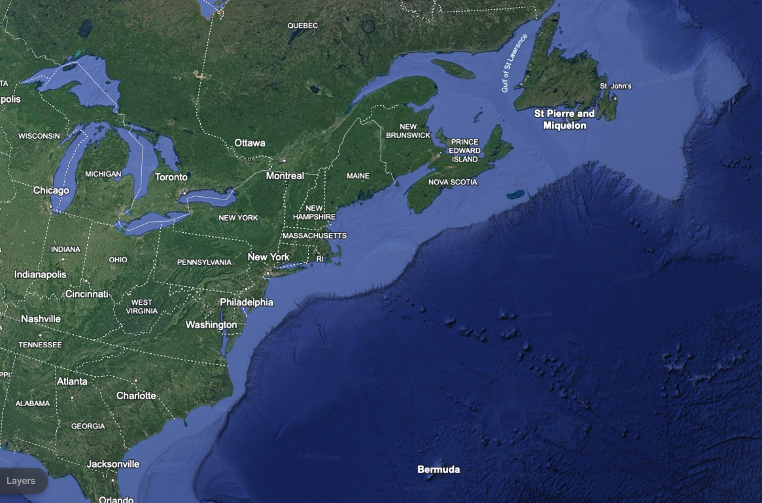
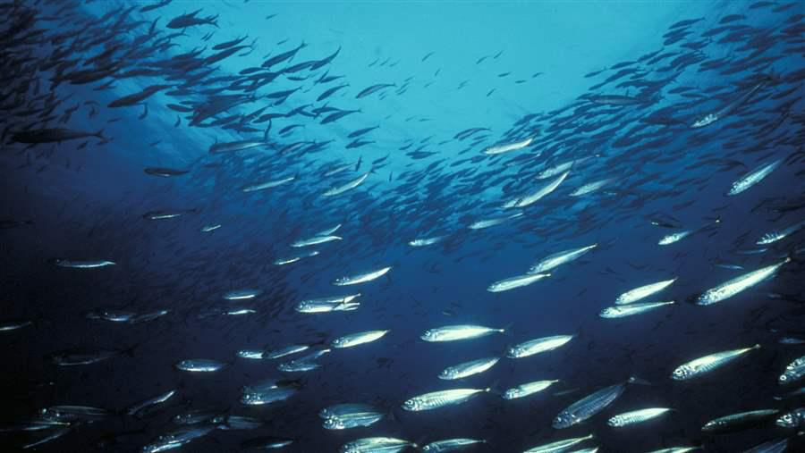
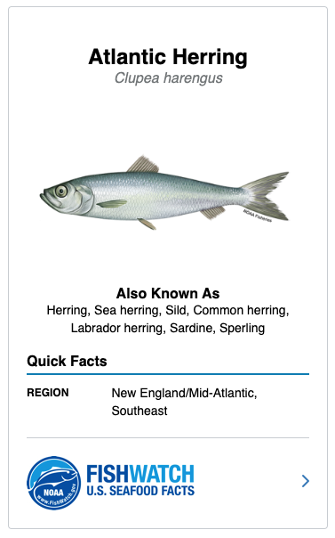
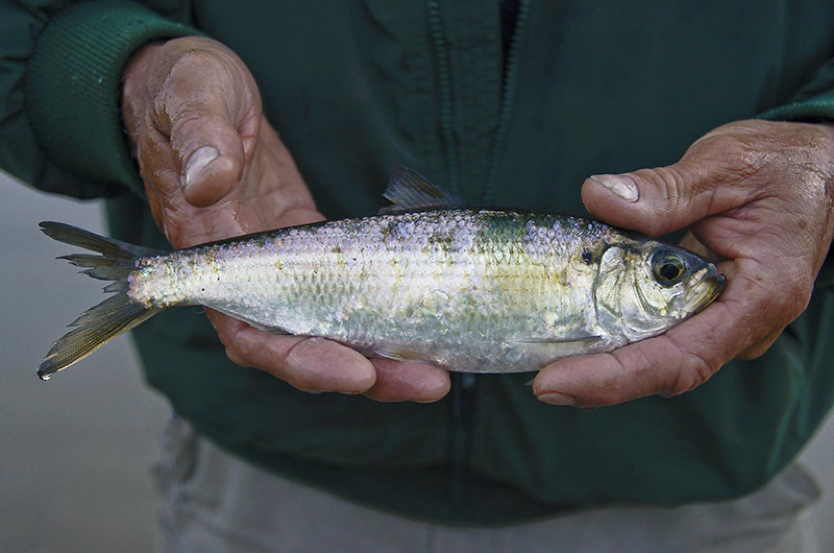

Slide 3
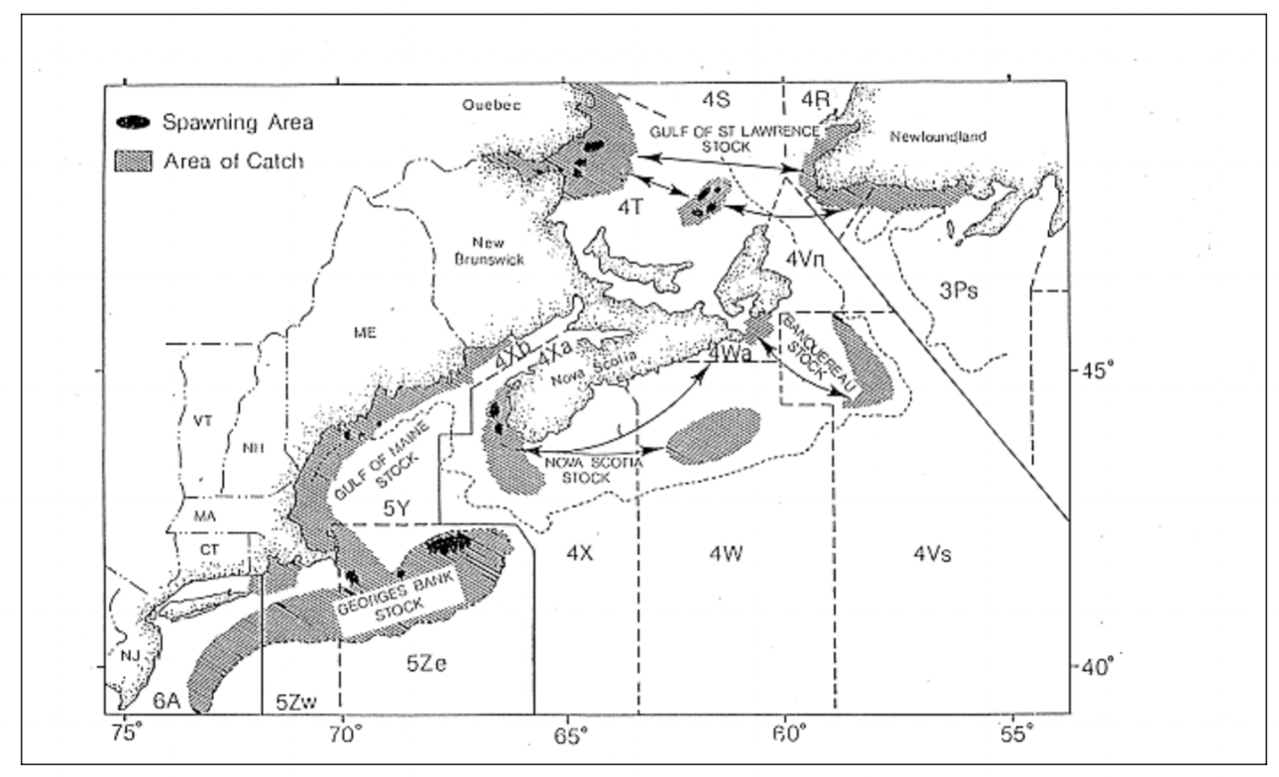
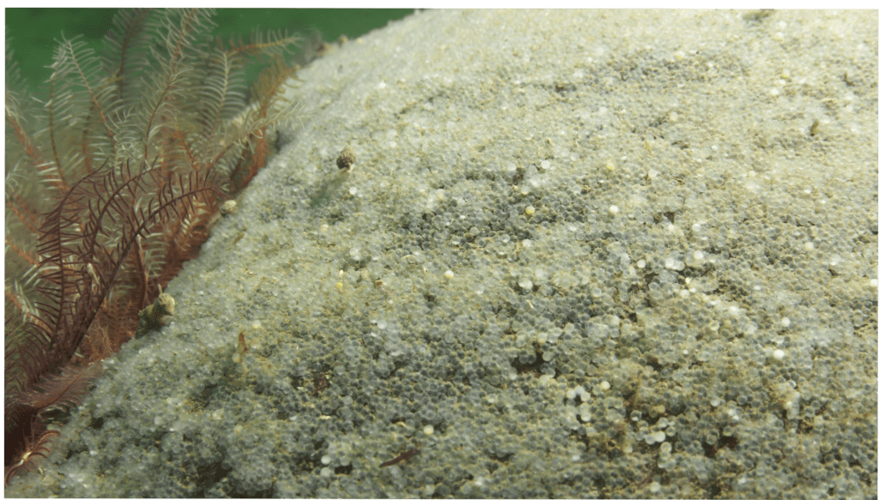

Slide 4
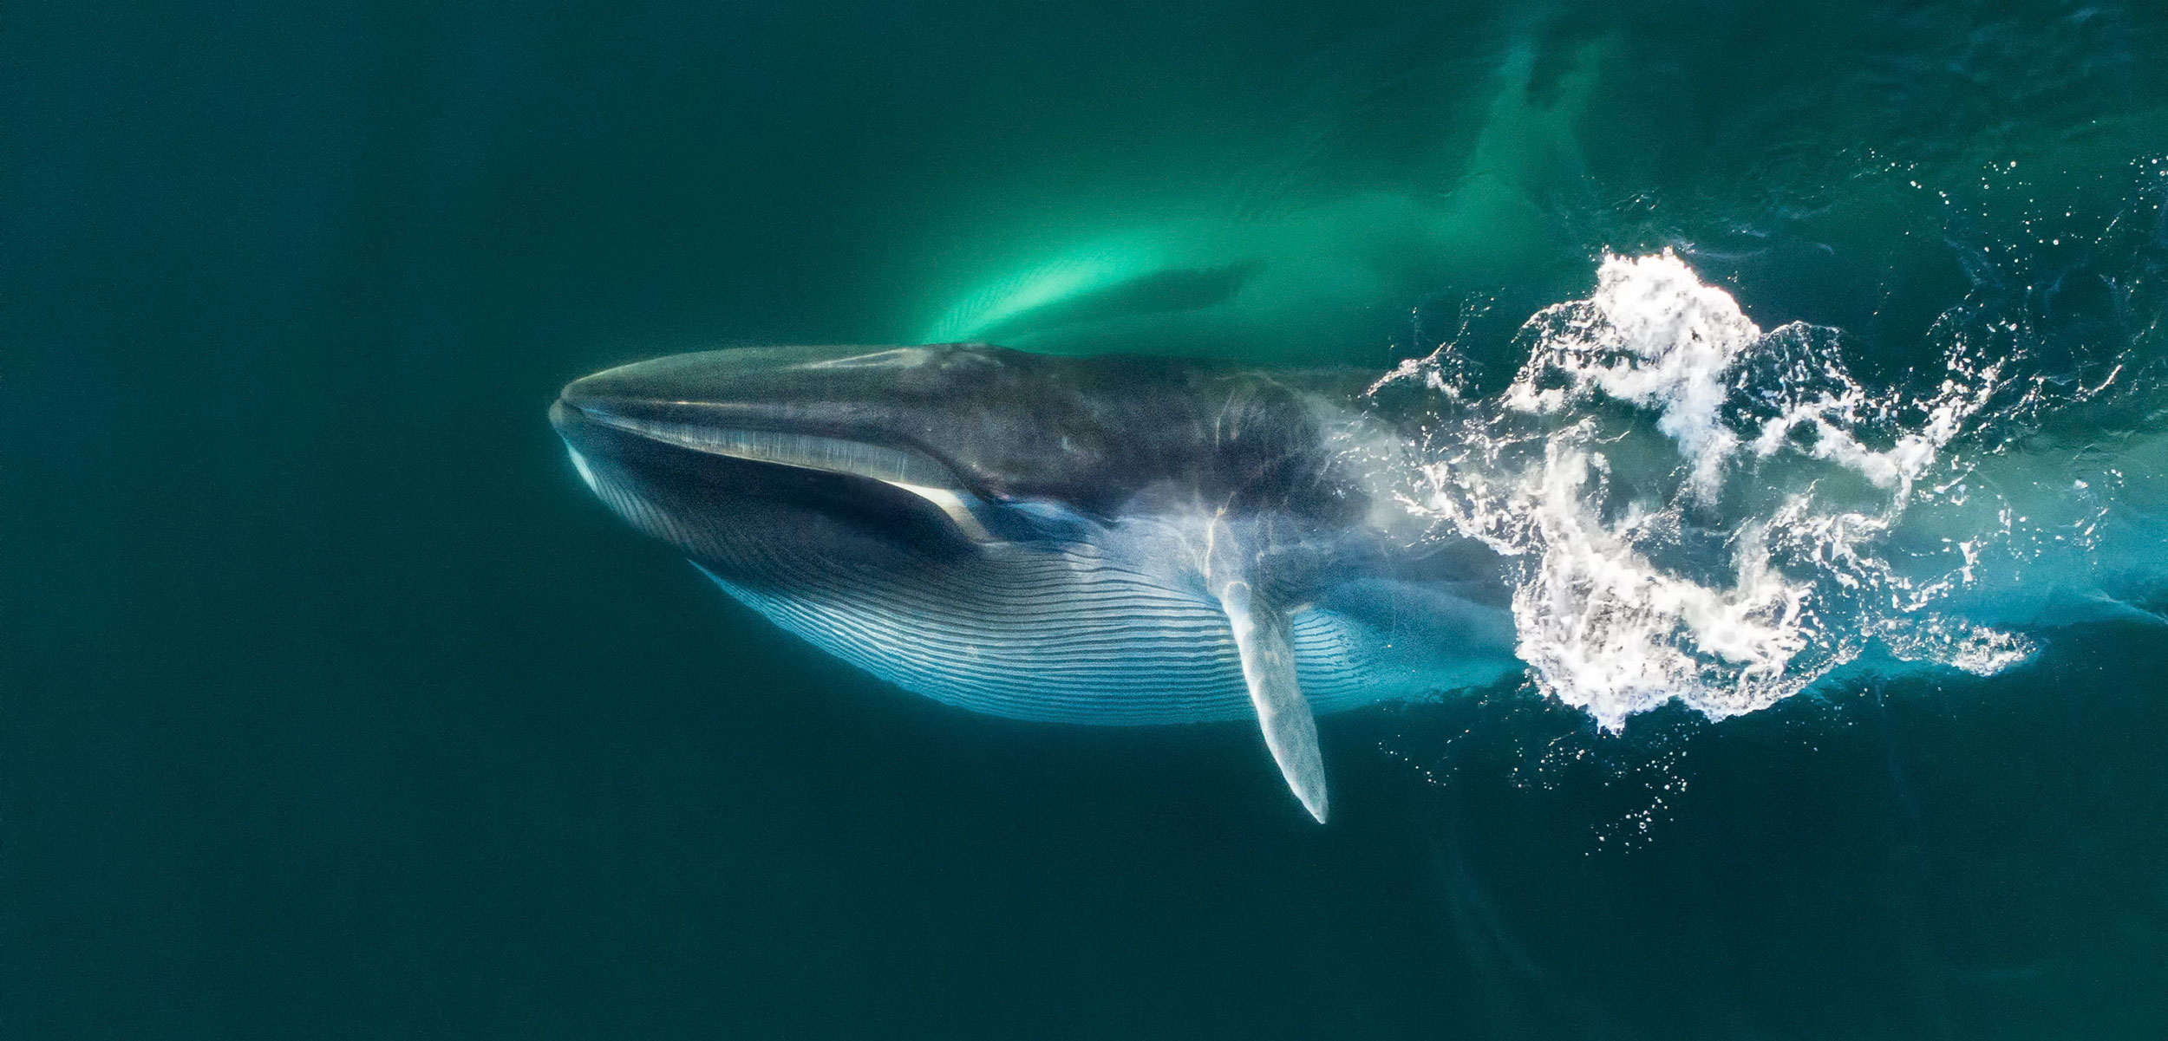
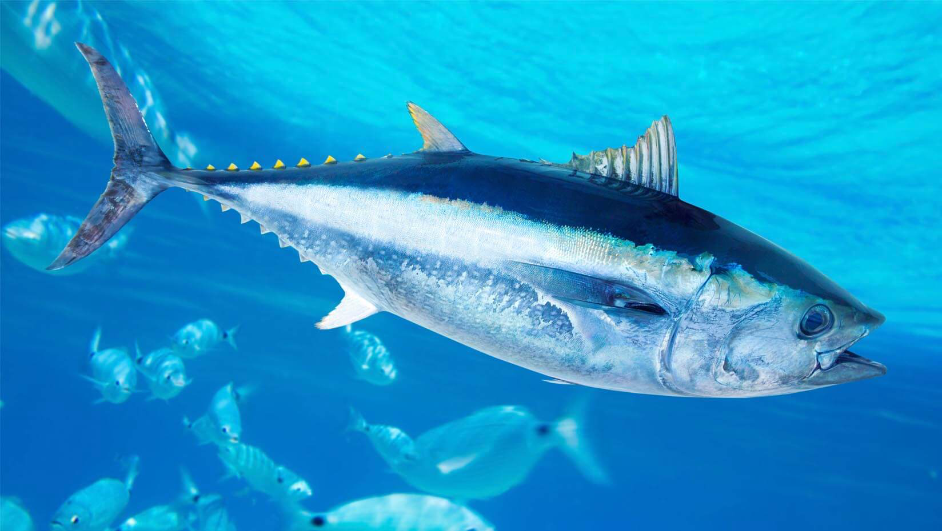
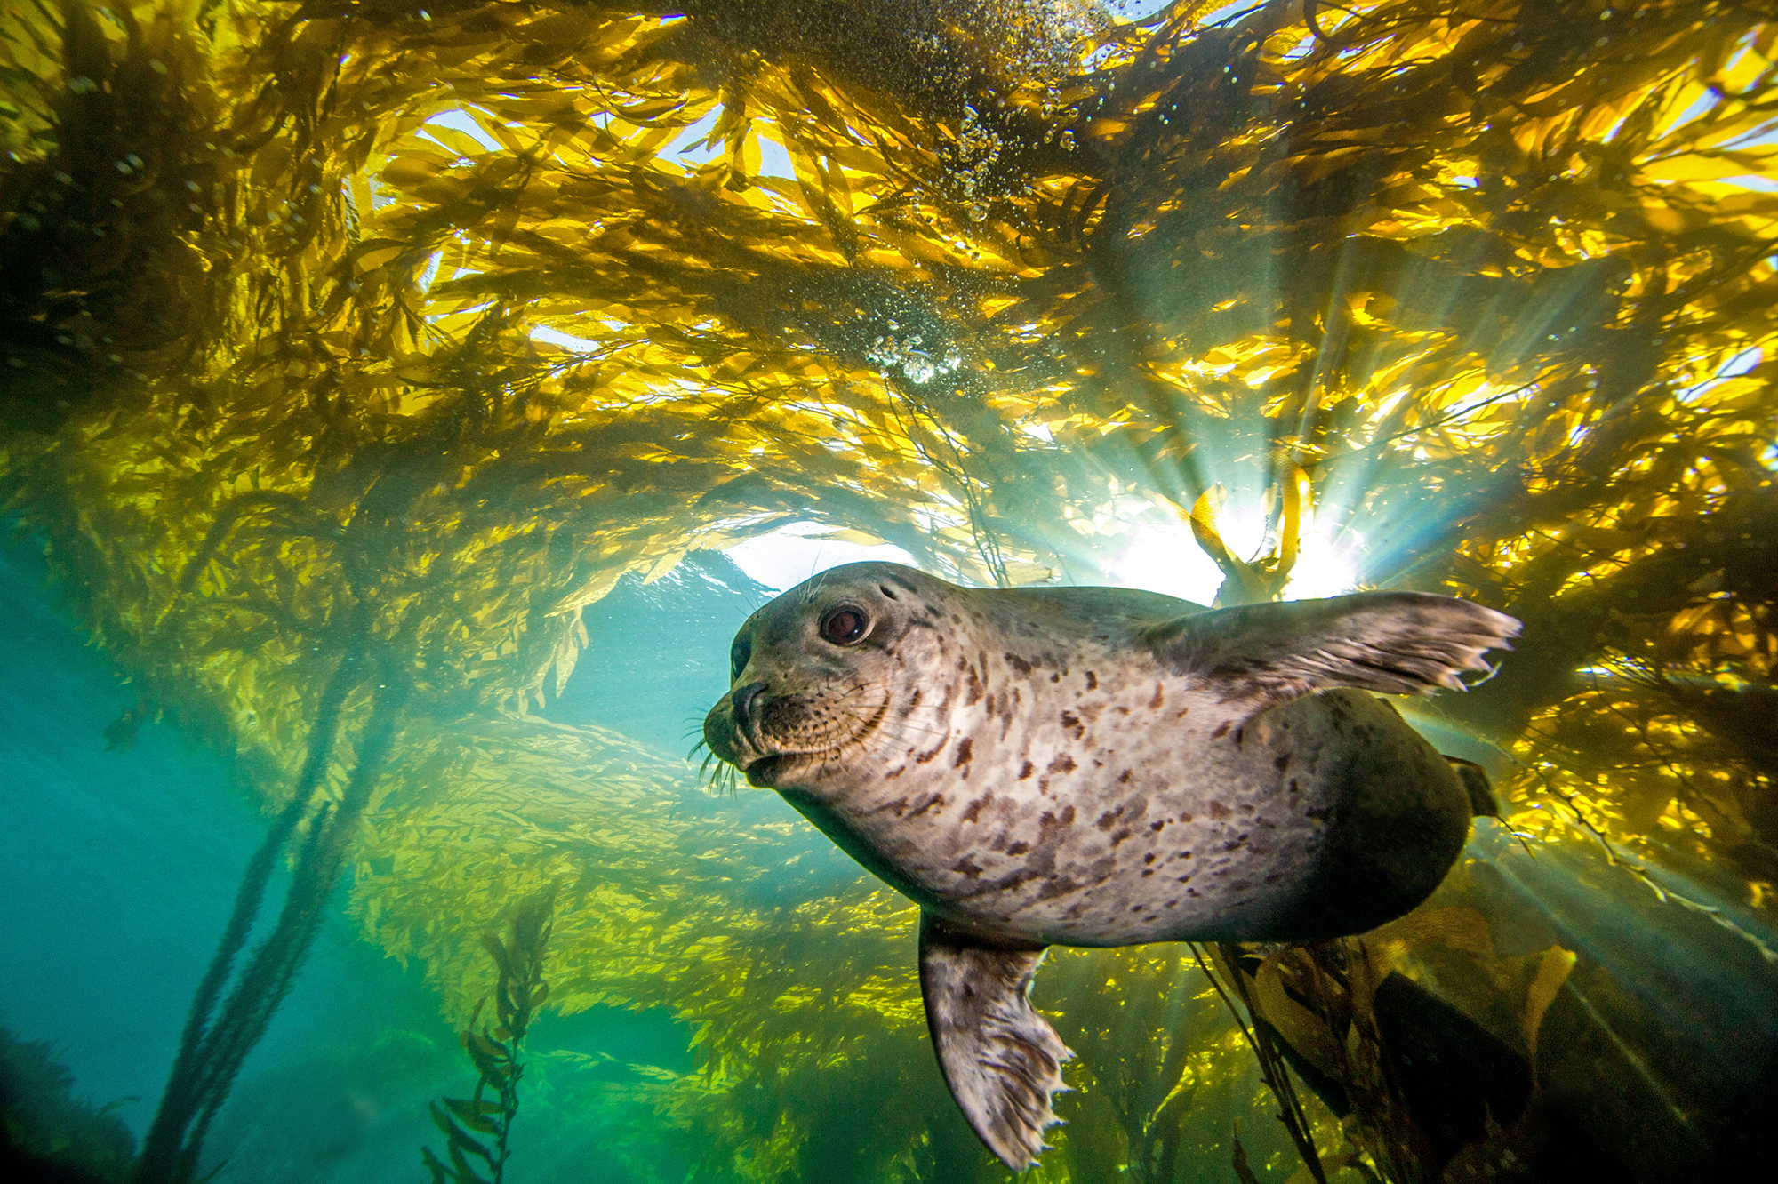
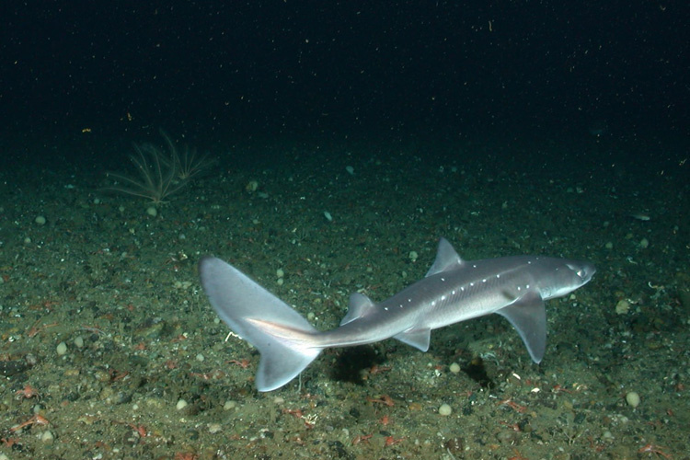

Slide 5
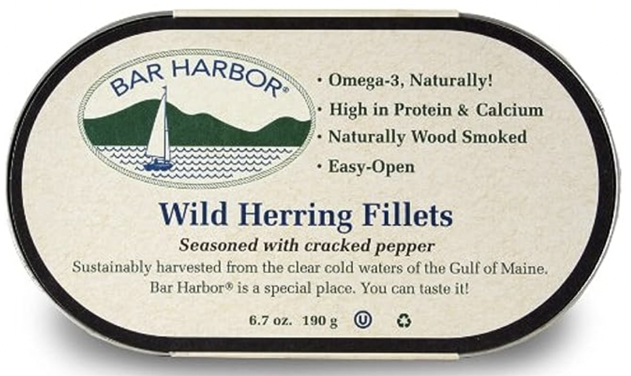
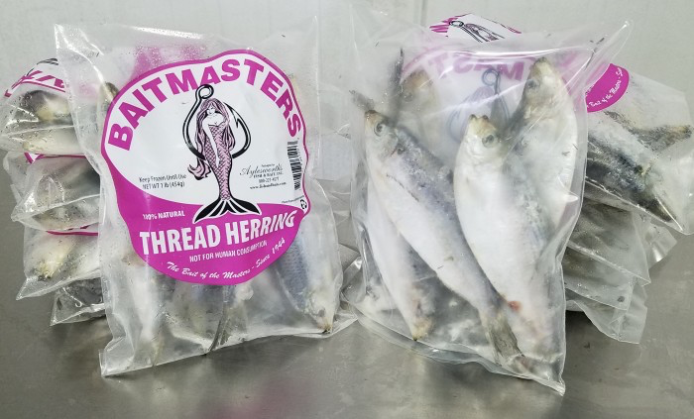
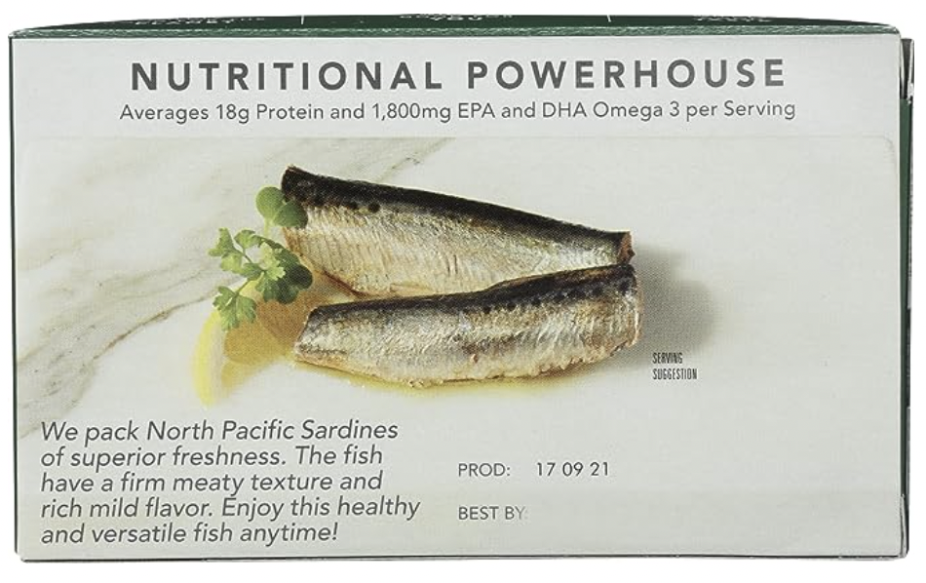
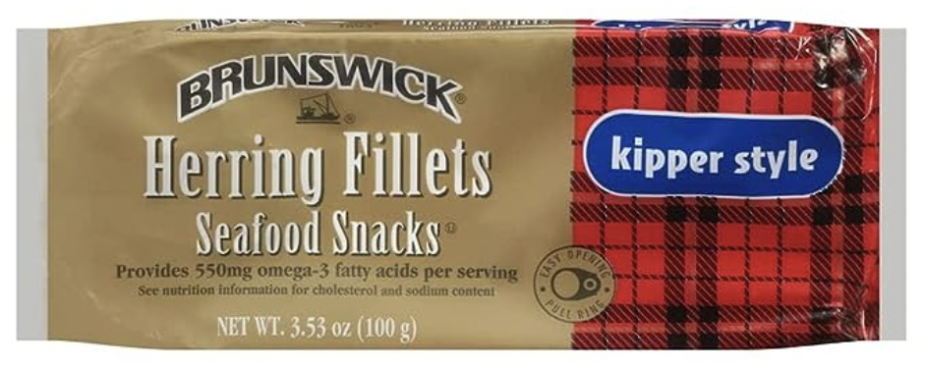
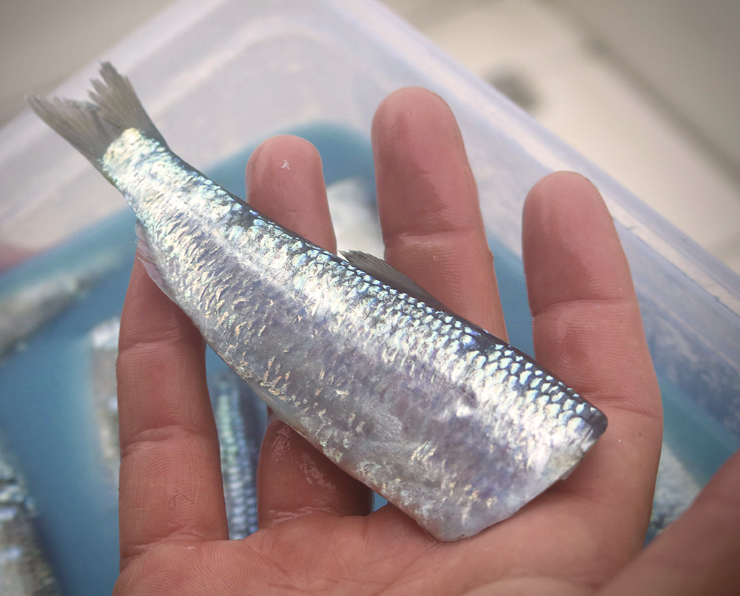
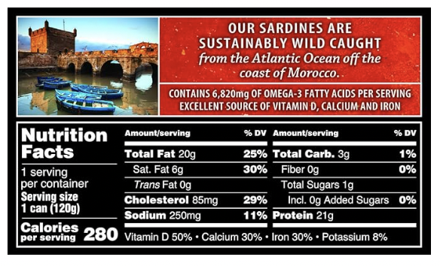

Slide 6
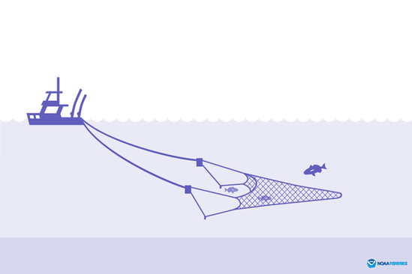
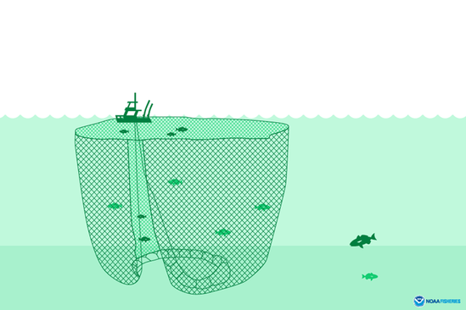
“In 1997, nearly 98 percent of the landings were made by 21 vessels, and 10 boats accounted for 92% of the catch.”
- Management Plan
“Herring vessels exceeding the size and horsepower restrictions may be issued a herring at-sea processing permit.”
-NOAA

Slide 7
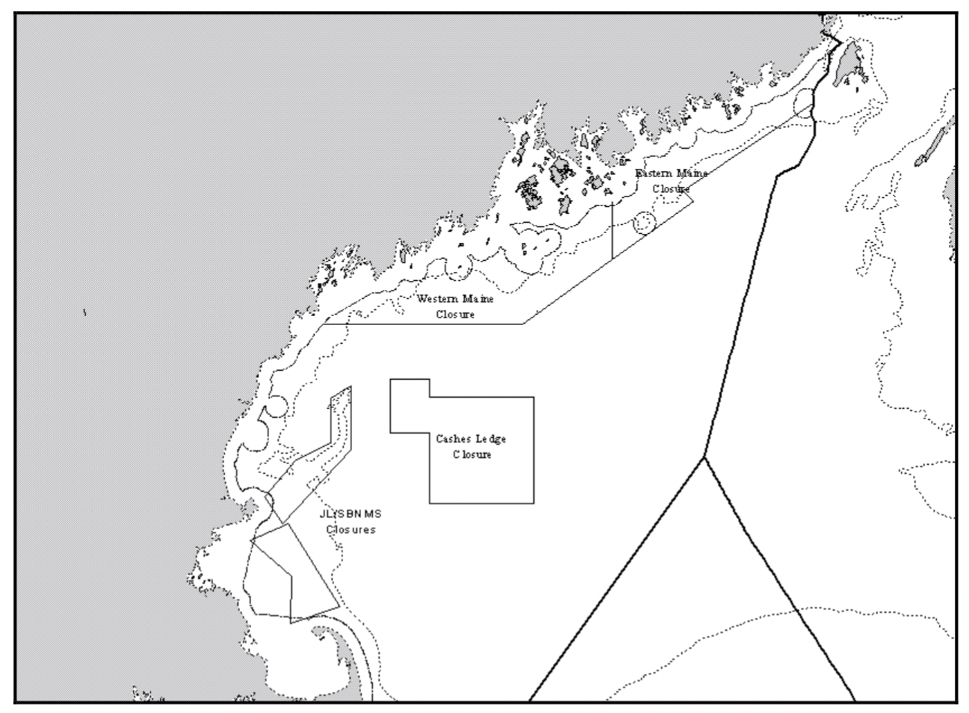
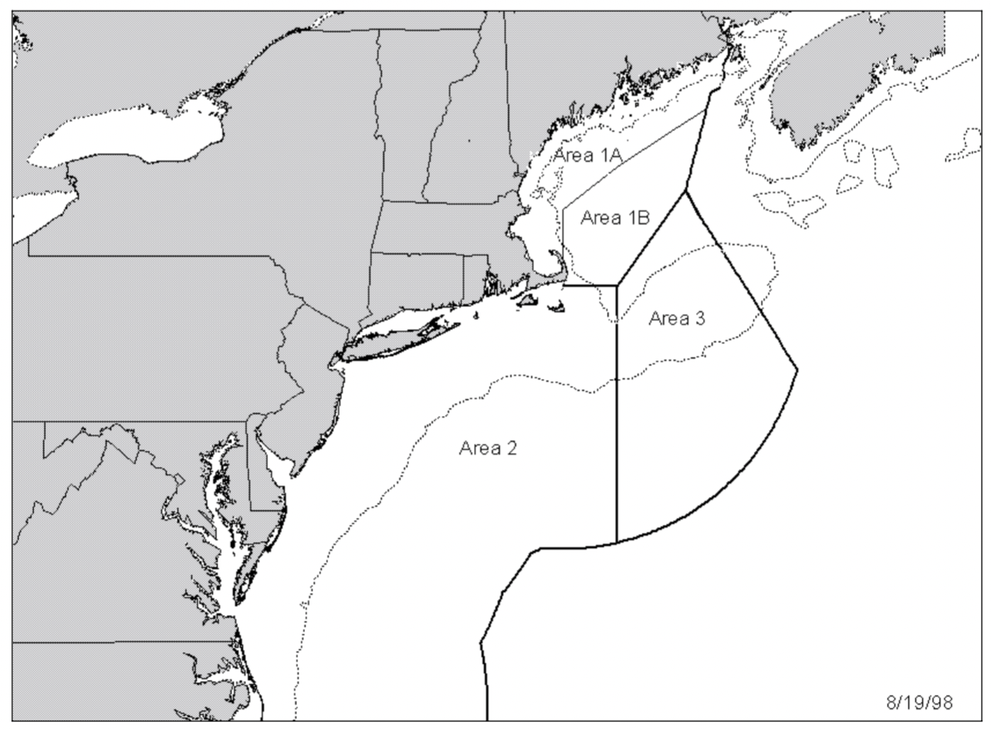
Fishing is open to all with very large vessels requiring specific kinds of permits.
Each management area has specific allowable catch limits that total up to the overall ACL
Once the fishery nears the ACL herring possession limits go into effect (2000lb)
Once either haddock or river herring is nearing its catch limit a similar minimum possession limit goes into place in areas these species are likely to be caught
There are also some spawning closures that go into affect to help support the rebuilding of the population

Slide 8
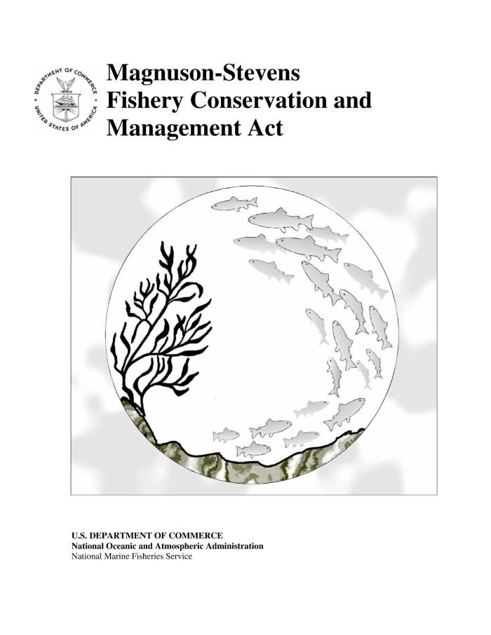
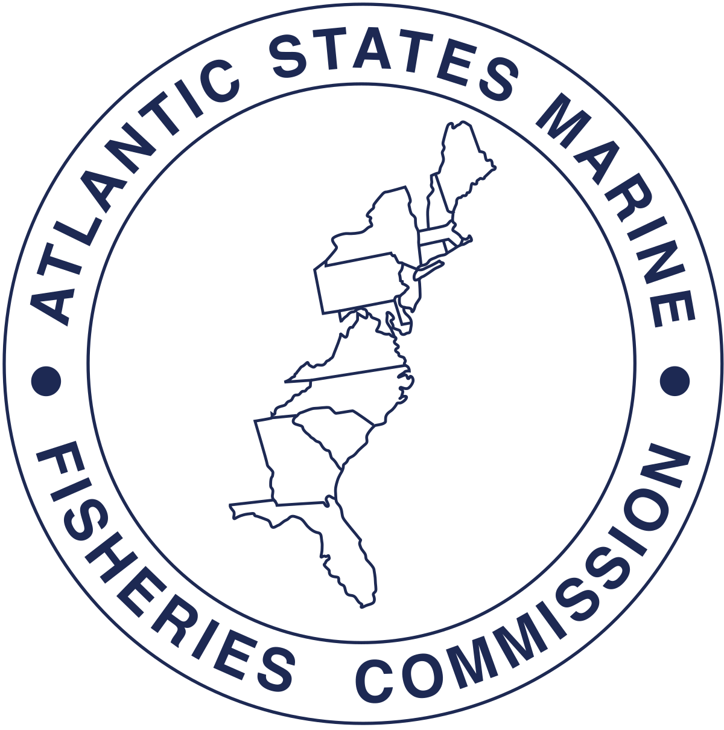

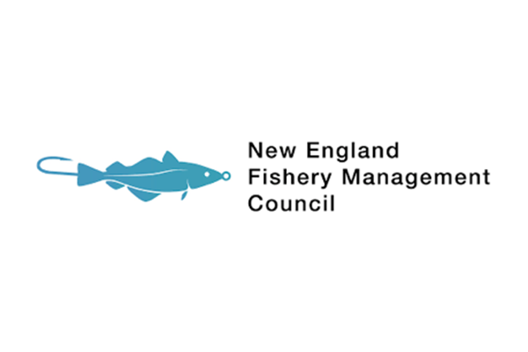

Slide 9
Modeling Sparknotes
Uses ASAP (Age Structured Assessment Program)
Allows for
Individual Age Cohorts
Multiple Fleets
Variable Gear Selectivity
Variable Recruitment
Fit With
Catch Data
Abundance Indices
Requires
Weight by Age
Natural Mortality by Age and Year
Fits
Fishing Mortality
Biomass
Selectivity
Recruitment

Slide 10
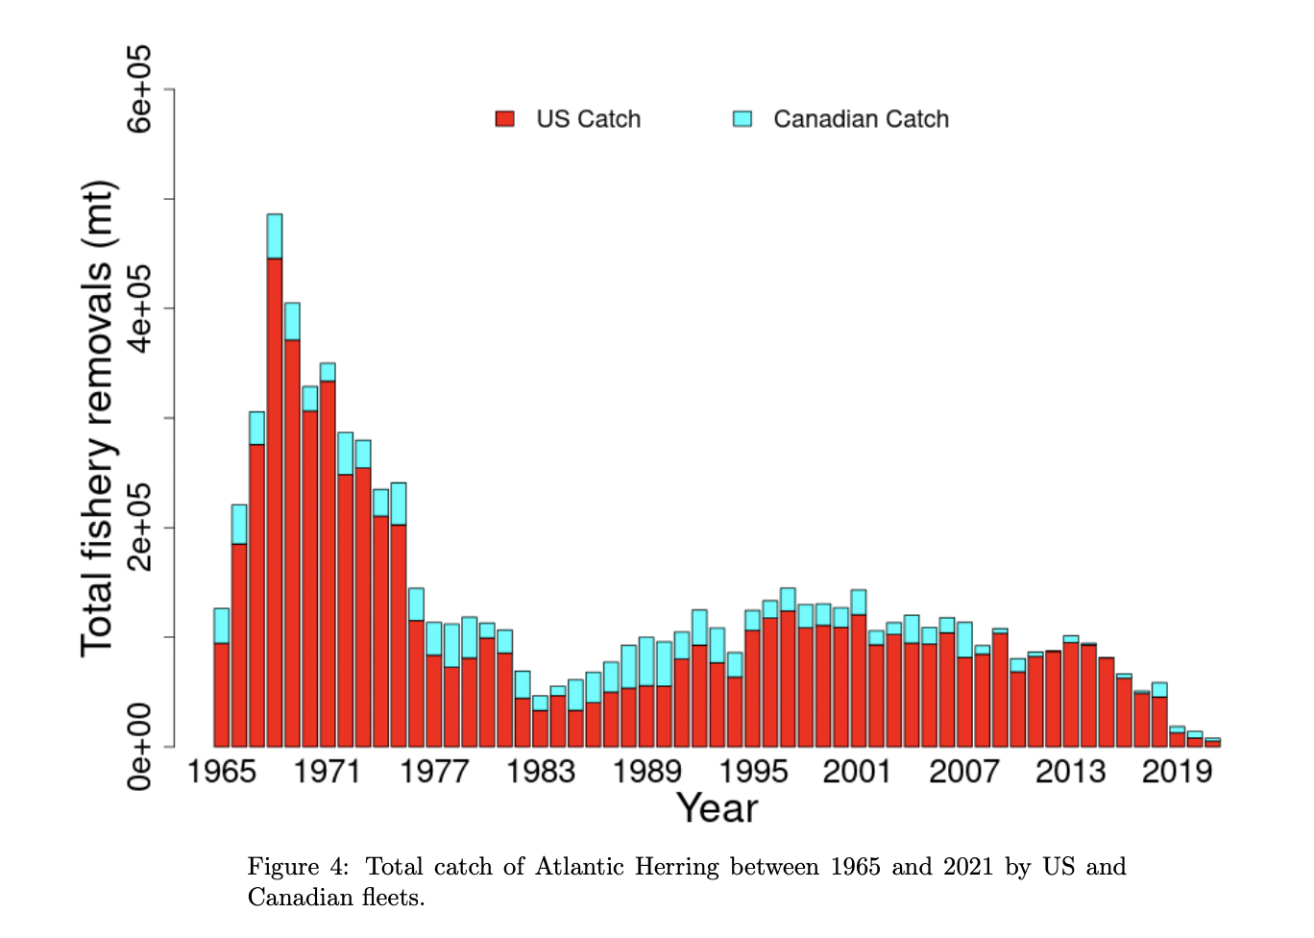
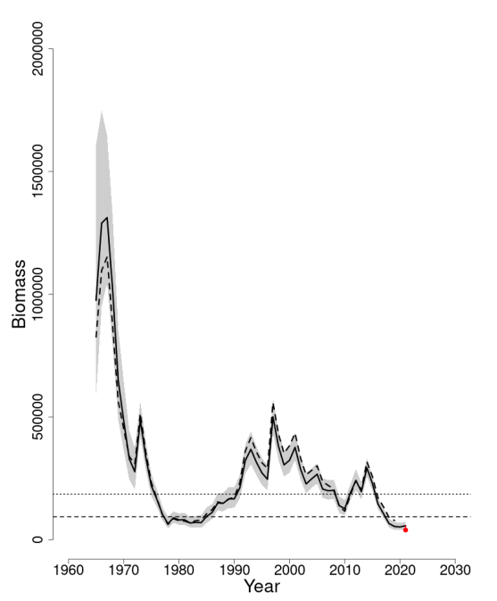
A reduced M would be required to more closely match the externally estimated consumption, but this creates a much larger retrospective pattern.

Slide 11
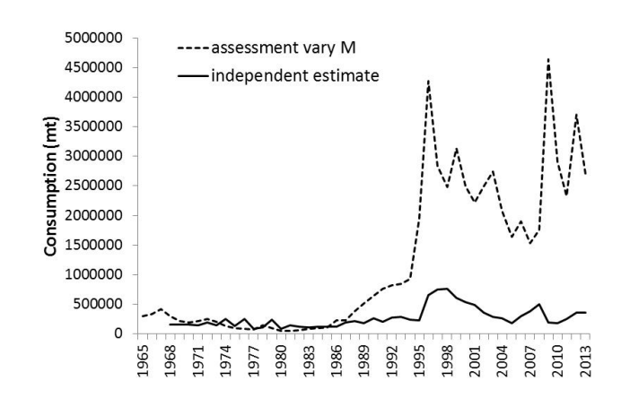
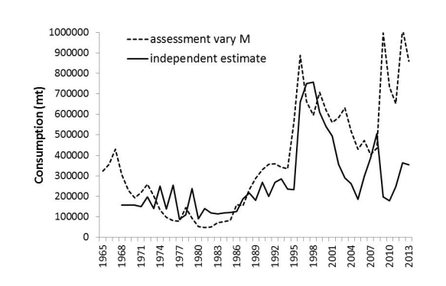
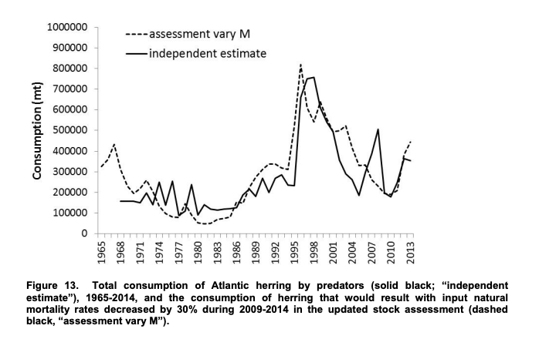
With a positive retrospective pattern (i.e., estimates of biomass for a given year decline as additional years of data are added)

Slide 12
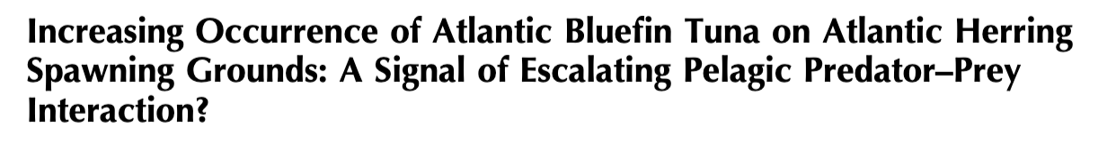
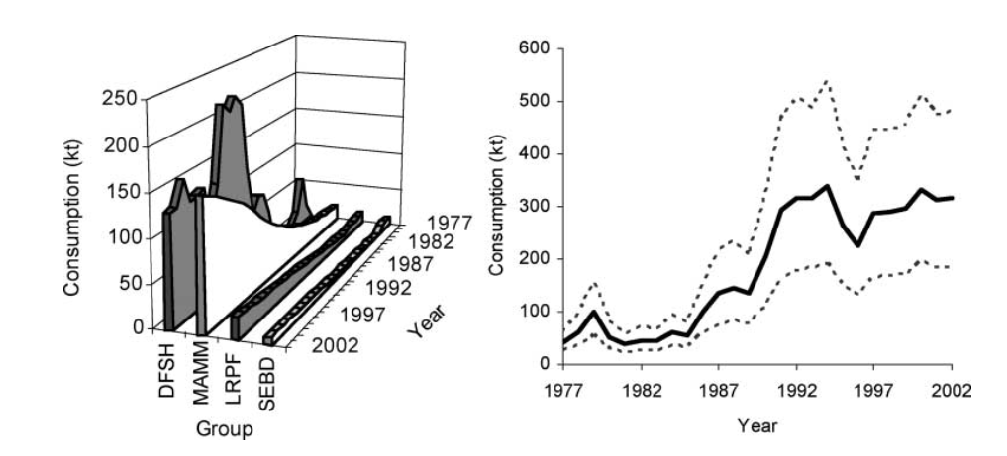

Slide 13
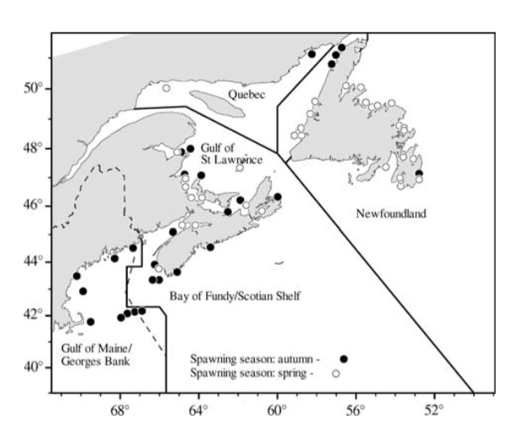
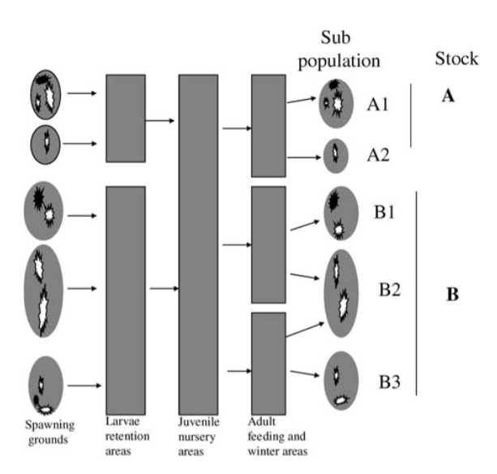
“Weights at age for spawning stock biomass (SSB) were estimated as the mean weights at age from the mobile gear fishery in quarter 3 of each year.”
- Assessment

Slide 14
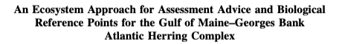
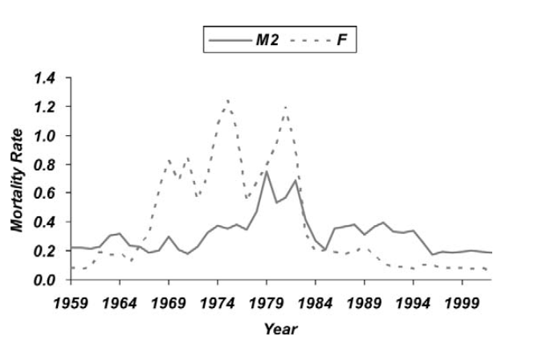
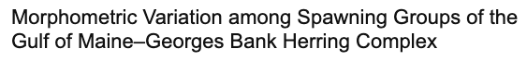
Two Fishing Fleets Multiple Species

Slide 15
References
Save the Bay
Fish and Bait
Commercial Bait
Fish Field
Norpel Bait
Wholesale Prices
Use in Lobster Fishery
Fishery Inputs/Pricin
Litigation by Midwater Trawlers
Reporting of Catch
ASMFC Assessment Summary Report
Manangement Reference Points
Mohn's Rho
Variation in Spawning Populations
Consumption Impacts on Atlantic Herring
Population Integrity of Atlantic Herring
Increasing Bluefin Occurrence
Ecosystem Approach to Atlantic Herring
Pre-catch and Discard Mortality
Management Plan
Current Conditions of NE US Shelf Ecosystem
Gulf of Maine Eutrophication
NOAA Atlantic Herring Report
NOAA Atlantic Herring Overview
MSC Fishery Factsheet Atlantic Herring
Temperature Change Effects on Juvenile Herring
ASMFC Atlantic Herring
NEFMC Atlantic Herring
NOAA Law Enforcement
Pew Trusts

Slide 16
Photo References
NOAA Atlantic Herring
Vineyard Gazette
Pew
Scottish Herring
Hakai Magazine
NPR
University of Maine
NOAA Atlantic Spiny Dogfish
Riptidefish
Fish and Bait

